Slide 1

Cloud Native Best Practices
Burt Liu
Tencent Cloud Vice President

Slide 2


Enterprise Container Cloud Platform – TKE Enterprise
Scenarios
Microservice
Devops
Big Data
Stateful
application
AI Platform
Blockchain
IoT
Management Tools
access
endpoint
webshell
Logs
configuration
management
webportal
api/sdk
operation
audit
One-stop Container Management Platform
On-Premise
Native Kubernetes Interface
GPU Virtualization
TAPP Application Management
Online & Offline Hybrid Deployment
Serverless Kubernetes (coming soon)
Hybrid Cloud Management (coming soon)
Authn & Authz
Platform Capability
Automated Operation
Code building
Image registry
App
management
Service
Orchestration
Load balancer
CBS
Management
code registry
permission
Auto scaling
compose
Cloud LB
Exclusive
CI
P2P
Grayscale upgrade
kubernetes
self-hosted
shared
Foundation
kubernetes
Unified Storage CEPH
（RBD、RGW、FS）
Docker
Container network
Installation Monitoring Operation Management
Infrastructure
（hardware、OS、network）
Tencent
Public Cloud
Private Cloud
Microservice
Big data/AI
Serverless
VM
Bare Metal
Serverless
Microservice
Big data/AI
Notes:
翻译

Slide 3




腾讯云容器服务网格 – TKE Mesh
Seamlessly Integrated：Automated service discovery and Ingress control
Out of the box：Mesh creation and management made simple
Deep Insights： multi-level visibility —topology, performance and tracing
Fully Control： traffic, security, and fault tolerance policies
TKE Mesh
Monitoring
Scaling Engine
Service registration
TKE Mesh
Service Discovery
Proxy
Proxy
Proxy
Proxy
TKE Mesh based on lstio
Proxy
CLB
service
TKE
service
service
service
service

Slide 4

Next Generation of Serverless
Tencent Serverless 2.0
Simple serverless experience：HTTP Function
Migrate legacy apps without code changes
High performance, low latency, no execution limits
Complete serverless solution including monitoring, debugging, and alerts

Slide 5


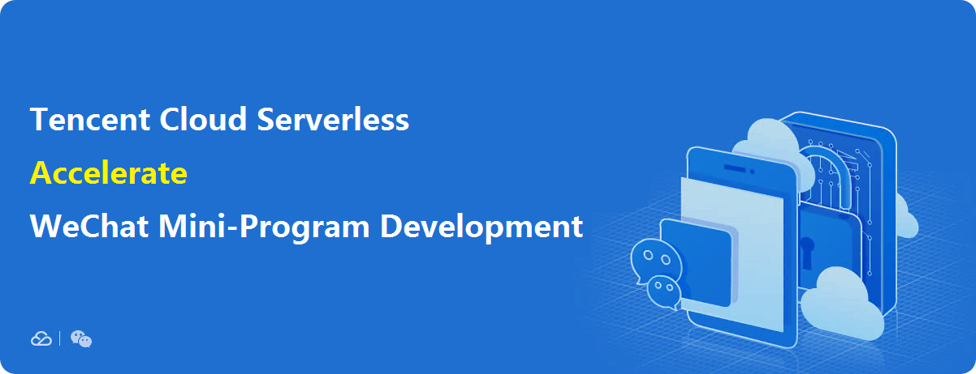
WeChat & Serverless
WeChat Mini-Program
Made simple
By Tencent Cloud Serverless

Slide 6
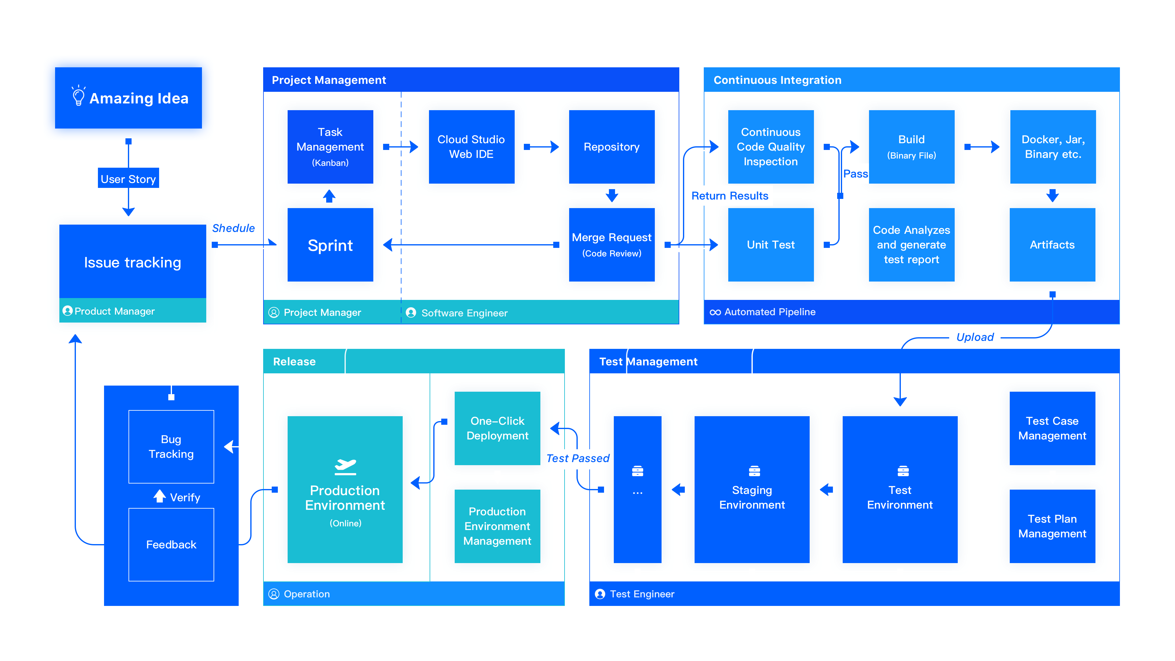





Build and Deploy Faster with CODING 2.0
Idea
Project
Develop
Test
Release

Slide 7

THANK YOU!

